Slide 1
ADASSM: Adversarial Data Augmentation in Statistical Shape Models From Images
Authors:- Mokshagna Sai Teja Karanam, Tushar Kataria, Krithika Iyer, and Shireen Y. Elhabian
Accepted in ShapeMI 2023 Workshop at MICCAI 2023, Vancouver
Presented by :- Mokshagna Sai Teja Karanam
Notes:
Introduce youself and say Introduction.

Slide 2
Outline
Introduction
Motivation
Methodology
Results
Conclusion and Future Work
Notes:
Say outlier and today whats going to cover first I will introduce some known concepts for the methodology to understand it better and then motivation behind my work folloiwed by the proposed methodolgy and results.

Slide 3
Introduction

Slide 4
Introduction – Statistical Shape Modeling
Statistical Shape Modeling (SSM) provides a statistically consistent geometrical description for each shape across a given population/set.
Set of cuboids:- 3 parameters length, breadth and height
Notes:
Start with real world shapes parameters , and ssm intro the line

Slide 5
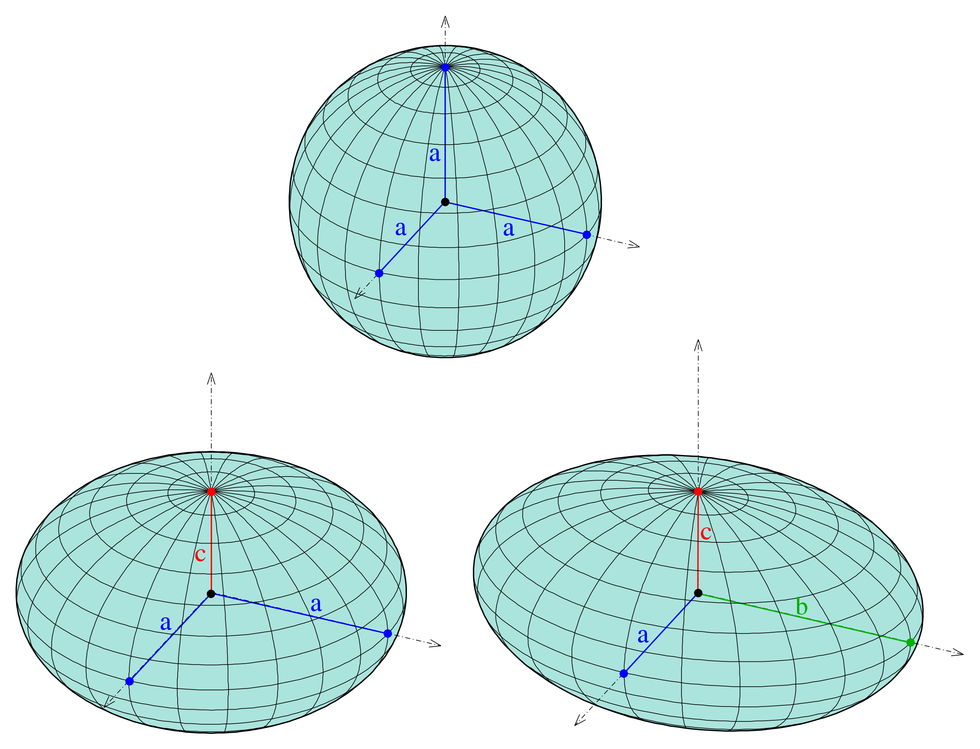
Introduction – Statistical Shape Modeling
Statistical Shape Modeling (SSM) provides a statistically consistent geometrical description for each shape across a given population/set.
Ellipsoid equation :
Set of cuboids:- 3 parameters length, breadth and height
Notes:
After that set of ellipsoids

Slide 6
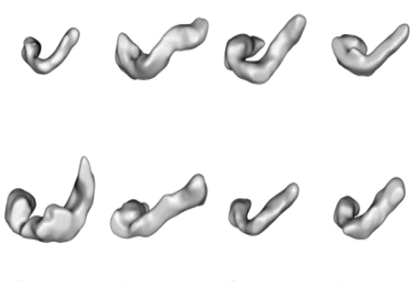
Introduction – Statistical Shape Modeling
Statistical Shape Modeling (SSM) provides a statistically consistent geometrical description for each shape across a given population.
In Medical imaging - Complex Shapes with unknown parameters
Pancreas
Hip & Femur
Ambellan, Felix, et al. "Statistical shape models: understanding and mastering variation in anatomy." Biomedical Visualisation. Springer, Cham, 2019.67-84.
Notes:
where as In medical imaging, we often come across various anatomical (complex) shapes with unknown parameters are encountered foe example like pancreas, hip and femur, which makes Statistical Shape Modeling a valuable tool.

Slide 7
Introduction - Shape Representations
Notes:
To represent the shapes There are two important types of shape representations. Implicit represnetation or a deformation based representation where all samples are modeled using reference shape or a template. explicit or correspondence shape representation , also known as landmark-based representation, which we'll refer to interchangeably as particles where each sample is modeled using a set of landmarks or correspondence points based on surface in a consistent manner acrross the population, as illustrated in the example of a hand the tip of the thumb particle is consistent across all the shapes which represent that area

Slide 8
Introduction - Shape Representations
Our Focus
Notes:
In this paper we focus on landmark based shape representation.

Slide 9
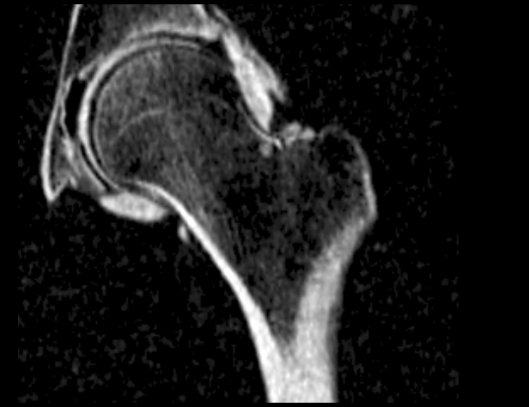
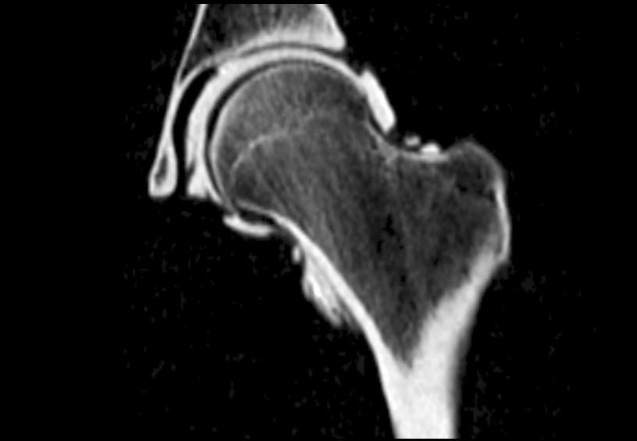
Traditional SSM
Inference pipelines of a state-of-the-art PDM
Pre-processing
Manual Segmentation
Aligning
Grooming
...
[*] Bhalodia, Riddish, et al. "Deepssm: A blueprint for image-to-shape deep learning models." arXiv preprint arXiv:2110.07152 (2022).
Notes:
traditional SSM methods typically involve preprocessing steps before obtaining landamark representations such as anatomy segmentation, data grooming which includes image resampling, denoising, rigid registration. using this groomed data, we need to optimize point distrubtion models which relies on dense correspondences for getting population-level shape representation, which are the set of correspondences placed on each anatomical surface in the shape population. Furthermore, we can apply some post processing steps to get the rich shape descriptors which can be used for various downstream tasks.

Slide 10
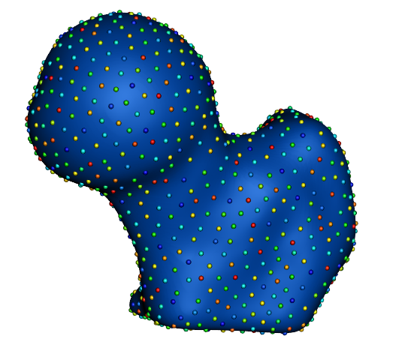
Traditional SSM
Inference pipelines of a state-of-the-art PDM
Pre-processing
PDM Optimization
[*] Bhalodia, Riddish, et al. "Deepssm: A blueprint for image-to-shape deep learning models." arXiv preprint arXiv:2110.07152 (2022).
Notes:
traditional SSM methods typically involve preprocessing steps before obtaining landamark representations such as anatomy segmentation, data grooming which includes image resampling, denoising, rigid registration. using this groomed data, we need to optimize point distrubtion models which relies on dense correspondences for getting population-level shape representation, which are the set of correspondences placed on each anatomical surface in the shape population. Furthermore, we can apply some post processing steps to get the rich shape descriptors which can be used for various downstream tasks.

Slide 11
Traditional SSM
Inference pipelines of a state-of-the-art PDM
Pre-processing
PDM Optimization
Post-Processing
Shape descriptor
[*] Bhalodia, Riddish, et al. "Deepssm: A blueprint for image-to-shape deep learning models." arXiv preprint arXiv:2110.07152 (2022).
Notes:
traditional SSM methods typically involve preprocessing steps before obtaining landamark representations such as anatomy segmentation, data grooming which includes image resampling, denoising, rigid registration. using this groomed data, we need to do heavy optimization on PDM(point distribution models) which relies on dense correspondences for getting population-level shape representation, which are the set of correspondences placed on each anatomical surface in the shape population. Furthermore, we can apply some post processing steps to get the rich shape descriptors which can be used for various downstream tasks.

Slide 12
Deep Learning based SSM (DeepSSM)
Using Deep Learning methods
Pre-processing
PDM Optimization
Post-Processing
Shape descriptor
Train Neural Network (DeepSSM)
[*] Bhalodia, Riddish, et al. "Deepssm: A blueprint for image-to-shape deep learning models." arXiv preprint arXiv:2110.07152 (2022).
Notes:
This shift towards deep learning-based methods offers a more efficient and automated approach to SSM, bypassing the need for extensive manual preprocessing and leveraging the power of neural networks to learn directly. To train the deep network robustly with limited data —a typical challenge in medical imaging applications

Slide 13
Motivation

Slide 14
Motivation - Data Augmentation
Deep Learning models are data hungry
Notes:
eep learning models are notorious for requiring enormous quantities of data to achieve acceptable performance [21], necessitating the useof data augmentation. Data augmentation has proved extremely useful by increasing training data variance to alleviate overfitting and improve deep neural networks’ generalization performance.

Slide 15
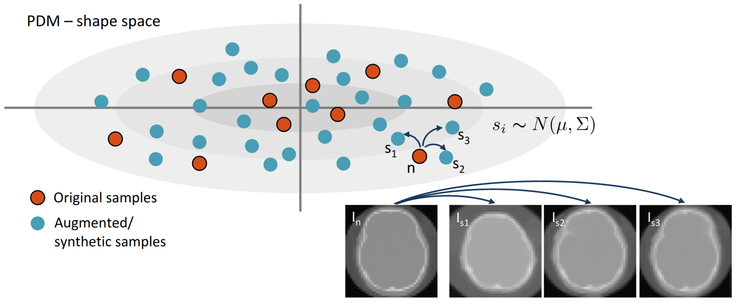
Motivation - Data Augmentation
Deep Learning models are data hungry
DeepSSM relies on offline shape-based data augmentation
[*] Bhalodia, Riddish, et al. "Deepssm: A blueprint for image-to-shape deep learning models." arXiv preprint arXiv:2110.07152 (2022).
Notes:
a generative model over the existing PDM space (also known as shape space). a non-parametric kernel density estimate (KDE) for modeling the PCA space of the correspondences. Augmentation is performed in PCA space and not directly on the shape space as it preserves the smoothness of the anatomy making it a more plausible shape without noise while still capturing all the subtleties of the original shape space

Slide 16
Motivation - Data Augmentation
Deep Learning models are data hungry
DeepSSM relies on offline shape-based data augmentation
Augmented samples are data dependent but task independent
[*] Bhalodia, Riddish, et al. "Deepssm: A blueprint for image-to-shape deep learning models." arXiv preprint arXiv:2110.07152 (2022).

Slide 17
Motivation - Data Augmentation
Deep Learning models are data hungry
DeepSSM relies on offline shape-based data augmentation
Augmented samples are data dependent but task independent
Focus on shape augmentation
[*] Bhalodia, Riddish, et al. "Deepssm: A blueprint for image-to-shape deep learning models." arXiv preprint arXiv:2110.07152 (2022).

Slide 18
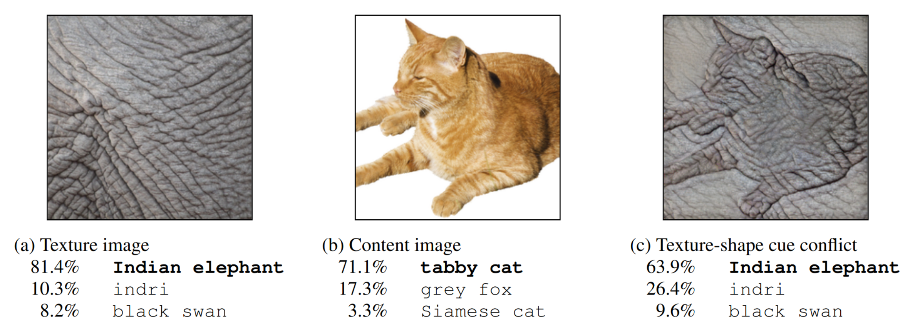
Motivation - Data Augmentation
Deep Learning models are data hungry
DeepSSM relies on offline shape-based data augmentation
Augmented samples are data dependent but task independent
Focus on shape augmentation
Ignores learned texture bias of convolutional models
Geirhos, Robert, et al. "ImageNet-trained CNNs are biased towards texture; increasing shape bias improves accuracy and robustness." arXiv preprint arXiv:1811.12231 (2018).

Slide 19
Motivation - Data Augmentation
Deep Learning models are data hungry
DeepSSM relies on offline shape-based data augmentation
Augmented samples are data dependent but task independent
Focus on shape augmentation
Ignores learned texture bias of convolutional models
Time intensive and resource consuming

Slide 20
Methodology

Slide 21
Proposed Methodology
Proposed an on-the-fly adversarial data augmentation method for Statistical Shape Modelling tasks with better generalization.

Slide 22
Proposed Methodology
Proposed an on-the-fly adversarial data augmentation method for Statistical Shape Modelling tasks with better generalization.
Texture Augmented (additive noise) samples are generated as an adversary to SSM Deep learning model

Slide 23
Proposed Methodology
Proposed an on-the-fly adversarial data augmentation method for Statistical Shape Modelling tasks with better generalization.
Texture Augmented (additive noise) samples are generated as an adversary to SSM Deep learning model
Generates both Task- and data- dependent samples.

Slide 24
Proposed Methodology
Proposed an on-the-fly adversarial data augmentation method for Statistical Shape Modelling tasks with better generalization.
Texture Augmented (additive noise) samples are generated as an adversary to SSM Deep learning model
Generates both Task- and data- dependent samples.
Shift from explicit shape augmentation to implicit shape attention.

Slide 25
Proposed Methodology
Proposed an on-the-fly adversarial data augmentation method for SSM tasks with better generalization.
Texture augmented (additive noise) samples are generated as an adversary to SSM Deep learning model.
Generates both task- and data- dependent samples.
Shift from explicit shape augmentation to implicit shape attention.
By augmenting texture, the model learns to ignore texture variations and focuses on the underlying shape.

Slide 26
Proposed Methodology
Proposed an on-the-fly adversarial data augmentation method for SSM tasks with better generalization.
Tested the approach on Left Atrium and Femur Datasets which has shown improved results.

Slide 27
Architecture

Slide 28
Architecture - ADASSM

Slide 29
Architecture - ADASSM
Notes:
TV loss also enables the generation of noise variations that exhibit smooth transitions, which is crucial for capturing the inherent features of real-world images

Slide 30
Architecture - ADASSM

Slide 31
Architecture - ADASSM

Slide 32
Regularization Using Contrastive loss
Projecting texture augmented and the corresponding original volume to the same latent representation.
Reinforces that texture variation should be ignored by the shape model.

Slide 33
Regularization Using Contrastive loss
Projecting texture augmented and the corresponding original volume to the same latent representation.
Reinforces that texture variation should be ignored by the shape model
Propose 2 different losses
Bottleneck Contrastive Loss
Ensures the augmentation does not affect the latent statistical shape representation of the augmented volume.

Slide 34
Architecture - ADASSM + BC

Slide 35
Regularization Using Contrastive loss
Projecting texture augmented and the corresponding original volume to the same latent representation.
Reinforces that texture variation should be ignored by the shape model
Propose 2 different losses
Bottleneck Contrastive Loss
Ensures the augmentation has less effect on the latent statistical shape representation of the augmented volume.
Particle Contrastive Loss
Ensures the augmentation has less effect on the final statistical shape representation of the augmented volume.

Slide 36
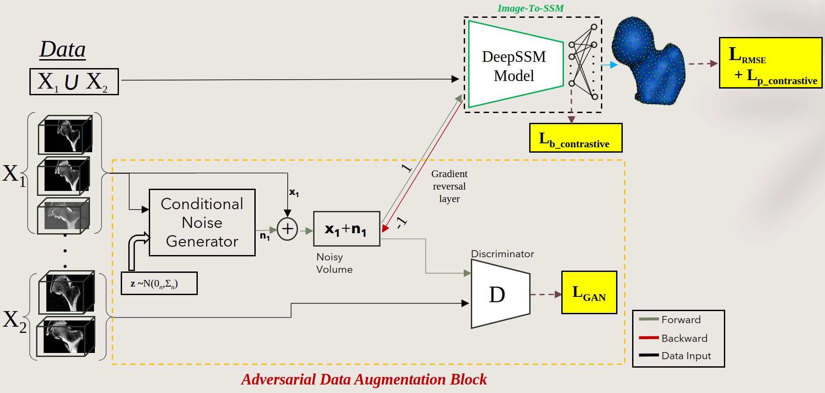
Architecture - ADASSM + BC + PC

Slide 37
Metrics
RMSE :
Surface-to-surface distance:
The surface-to-surface distance is measured between the ground truth mesh and the mesh reconstructed from the predicted correspondences.
Calculate average of Euclidean distance from each point of the ground truth mesh to the closest point of the predicted mesh.

Slide 38
Dataset Preprocessing
​ | Left Atrium​ | Femur​
Modality​ | MRI​ | CT​
Image Size​ | 117 x 69 x 87​ | 130 x 92 x 117​
PCA Modes​ | 25​ | 20​
Train-Val-Test​ | 146-30-30​ | 30-10-9​
Voxel Spacing​ | 1.25 mm​ | 1 mm​

Slide 39
Results

Slide 40
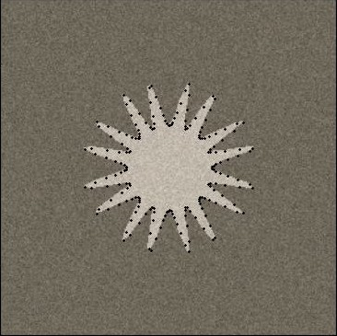
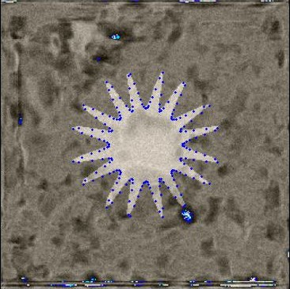
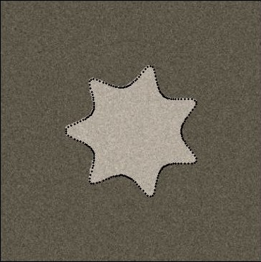
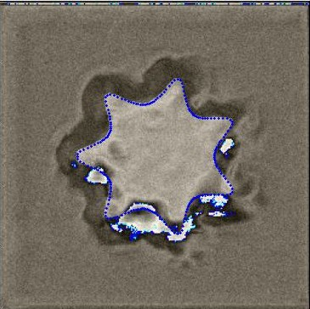
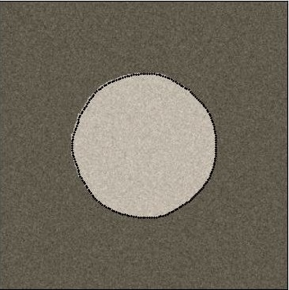
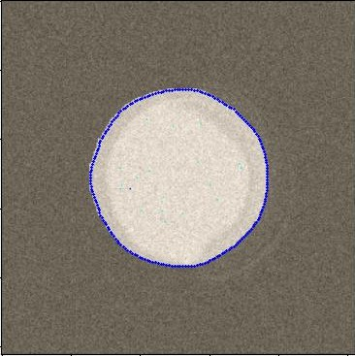
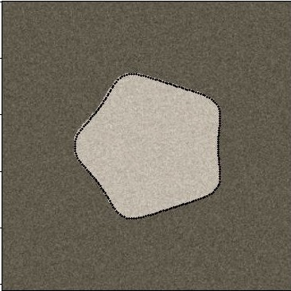
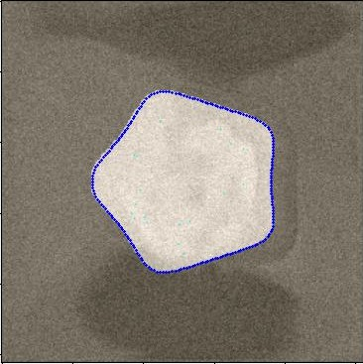
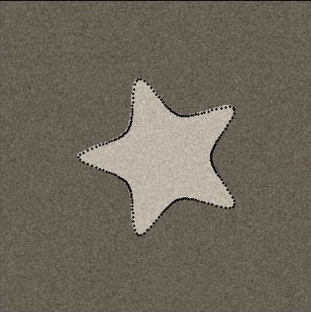
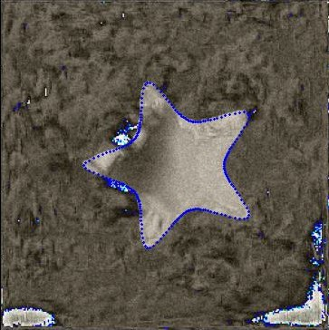
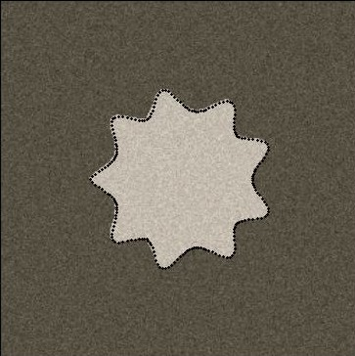
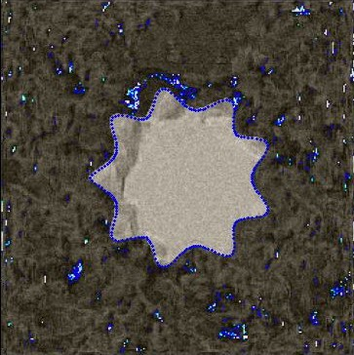
Qualitative Results – 2D Super Shapes
Classification Task Noisy Samples
Regression Task Noisy Samples
Classification + Regression Task Noisy Samples

Slide 41
Results : Femur
λ1 for ADASSM+BC is 0.5, λ2 for ADASSM+PC is 0.1 and λ1, λ2 for ADASSM+BC+PC is 0.5.

Slide 42
Results : Femur : Reconstruction
Comparing DeepSSM outputs with our model's predictions.
Assessing surface-to-surface distance for model evaluation.

Slide 43
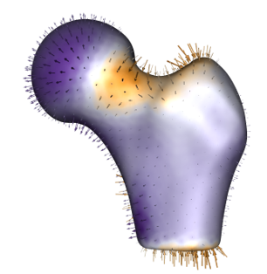
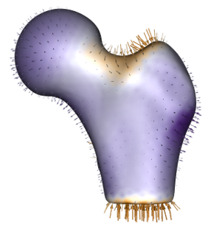
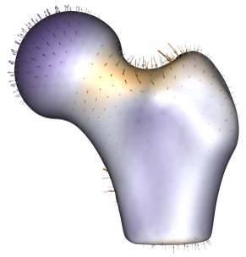
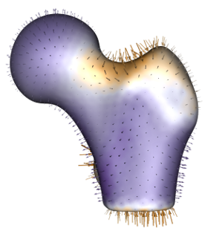
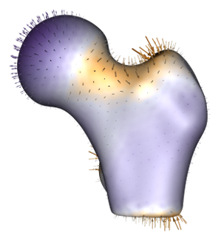
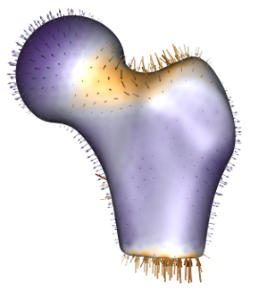
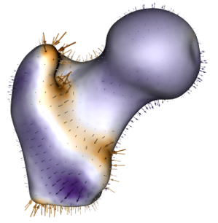
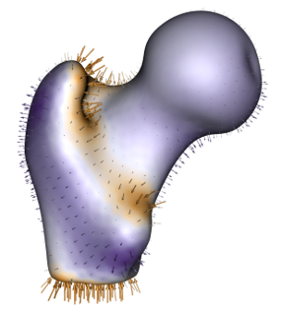
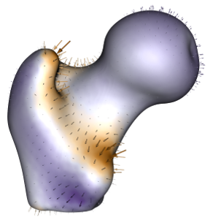
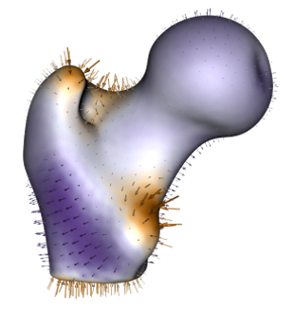
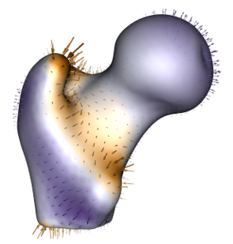
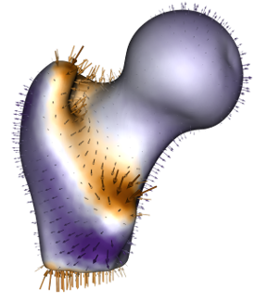
Results: Femur : Downstream Task: Group Differences
PDM
KDE [5]
ADASSM
ADASSM + BC
ADASSM + PC
ADASSM + BC + PC
Greater Trochanter
Neck
Lesser Trochanter

Slide 44
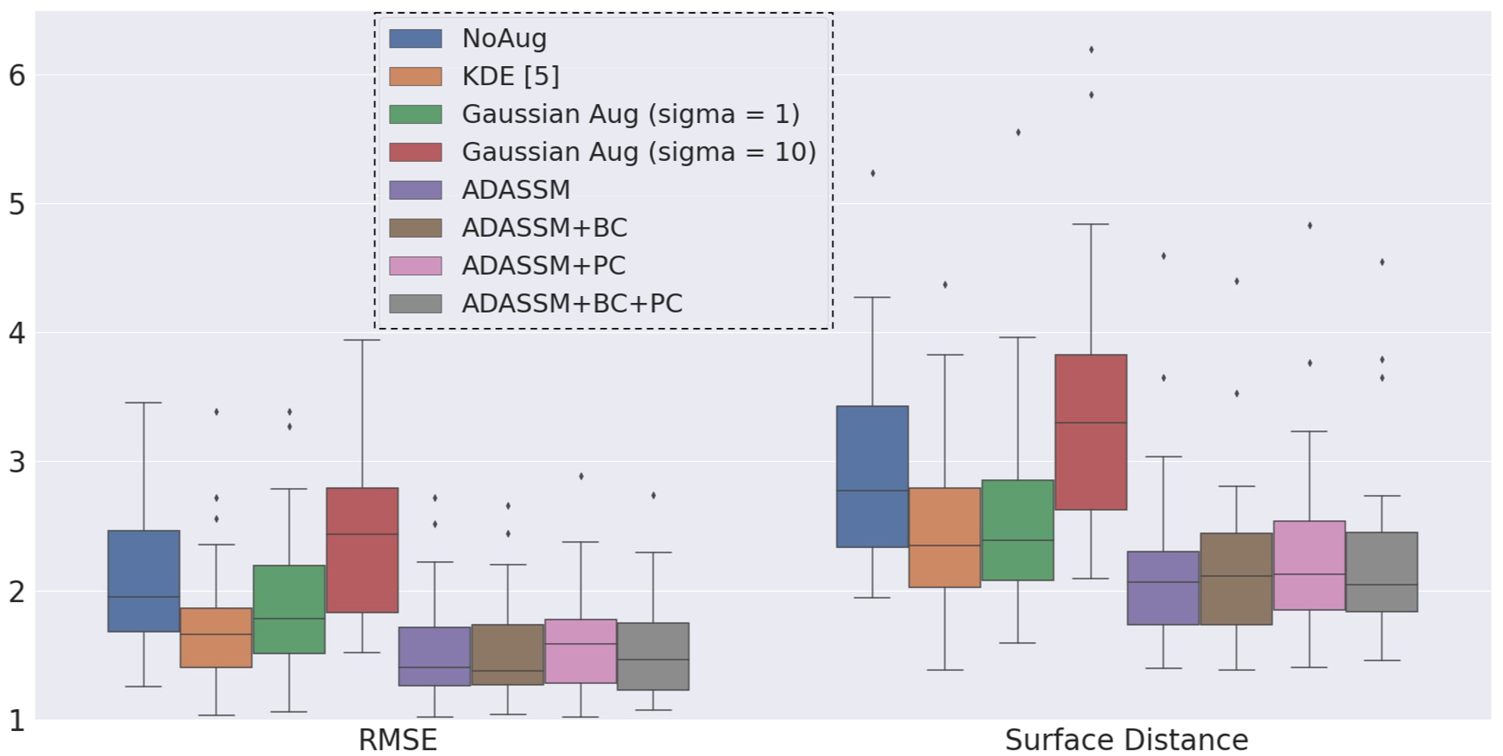
Results: Left Atrium
λ1 for ADASSM+BC is 0.001, λ2 for ADASSM+PC is 0.05 and λ1, λ2 for ADASSM+BC+PC is 0.05.

Slide 45
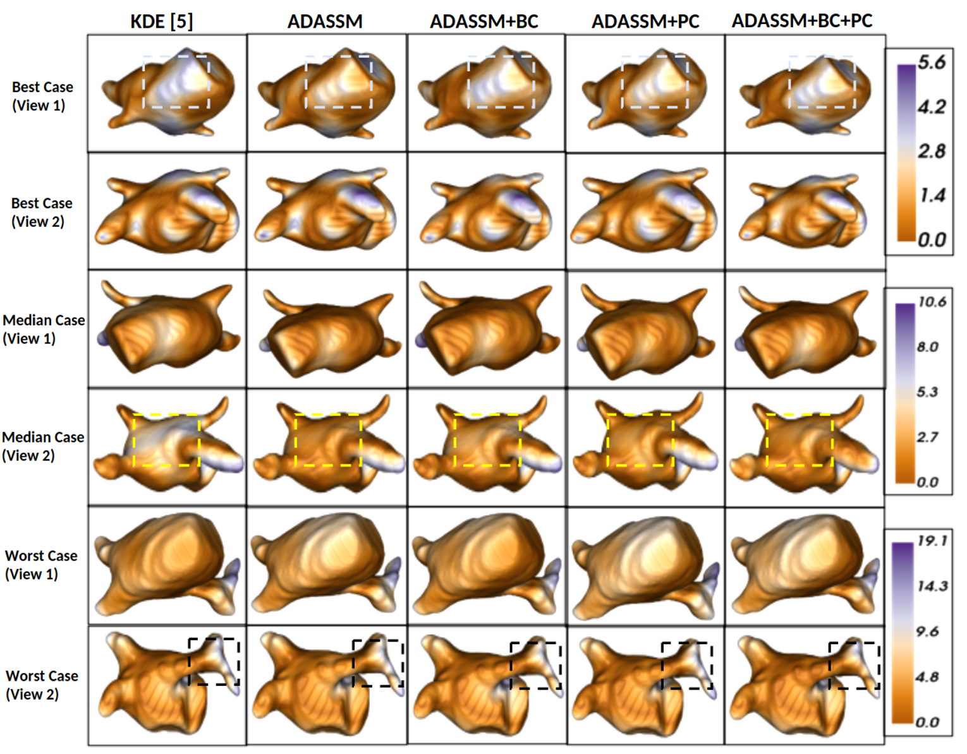
Results : Left Atrium : Reconstruction
Comparing DeepSSM outputs with our model's predictions.
Surface-to-surface distance for model evaluation.

Slide 46
Results: Left Atrium : Downstream Task: AF Recurrence Prediction
Model​ | Accuracy​
ShapeWorks​ | 53.99% ± 6.2​
KDE​ | 52.99% ± 1.77​
Gaussian Aug(sigma = 1)​ | 50.66% ± 6.22​
Gaussian Aug(sigma = 10)​ | 51.99% ± 7.11​
ADASSM​ | 51.33% ± 2.66​
ADASSM + BC​ | 55.99% ± 15.11​
ADASSM + PC​ | 67.99% ± 2.67​
ADASSM + BC + PC​ | 51.33% ± 2.66​
AF Recurrence Prediction: Accuracy of AF recurrence that uses PCA scores as shape descriptors from different models.

Slide 47
Training time comparison
Enhances model performance and reduces training time by 60%.
Dataset​ | KDE (Aug + Model)​ | ADASSM​
Left Atrium​ | 690.35+122.35 minutes​ | 336.15 minutes​
Femur​ | 725.35+93.5 minutes​ | 399.6 minutes​

Slide 48
Conclusion

Slide 49
Conclusion
Proposed an On-the-Fly Adversarial data augmentation for Statistical Shape Modelling which is computationally efficient
Showed that task dependent texture augmentation is better than fixed (Gaussian) texture augmentation.
Task Dependent texture augmentation performs better than KDE based shape augmentation
Models trained using texture augmentation also outperform on downstream tasks.

Slide 50
Future Work
Task dependent shape augmentation
Multi-task adversary

Slide 51
Questions

