Slide 1
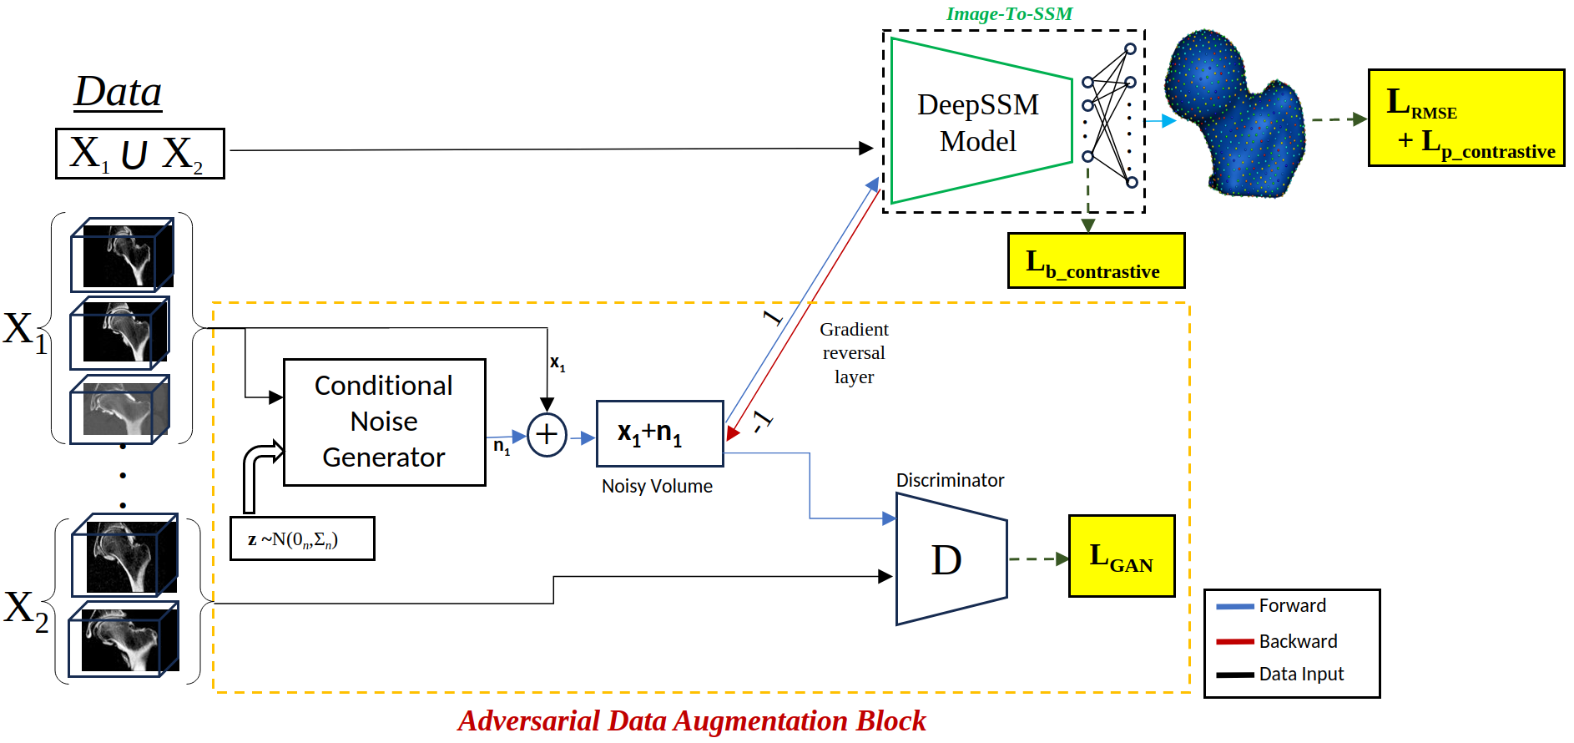
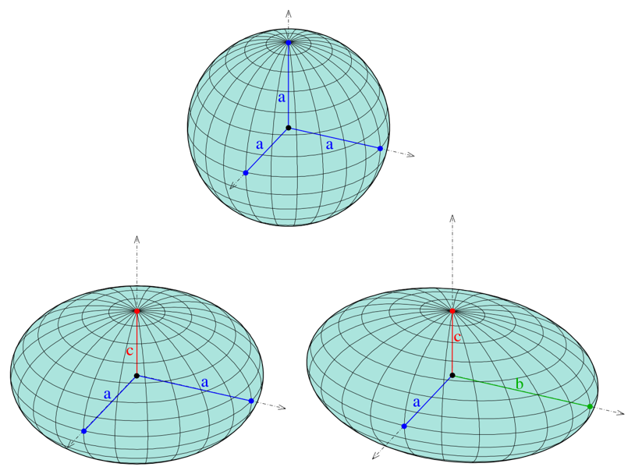
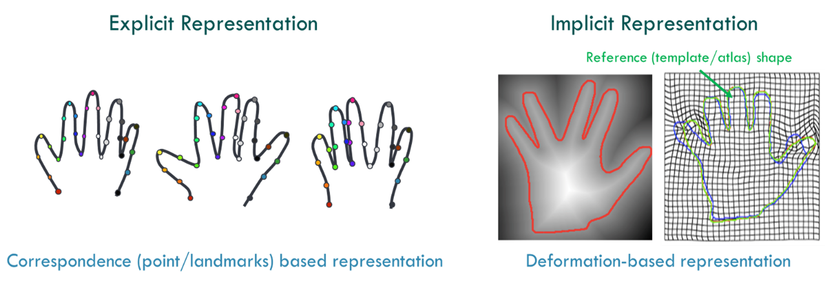
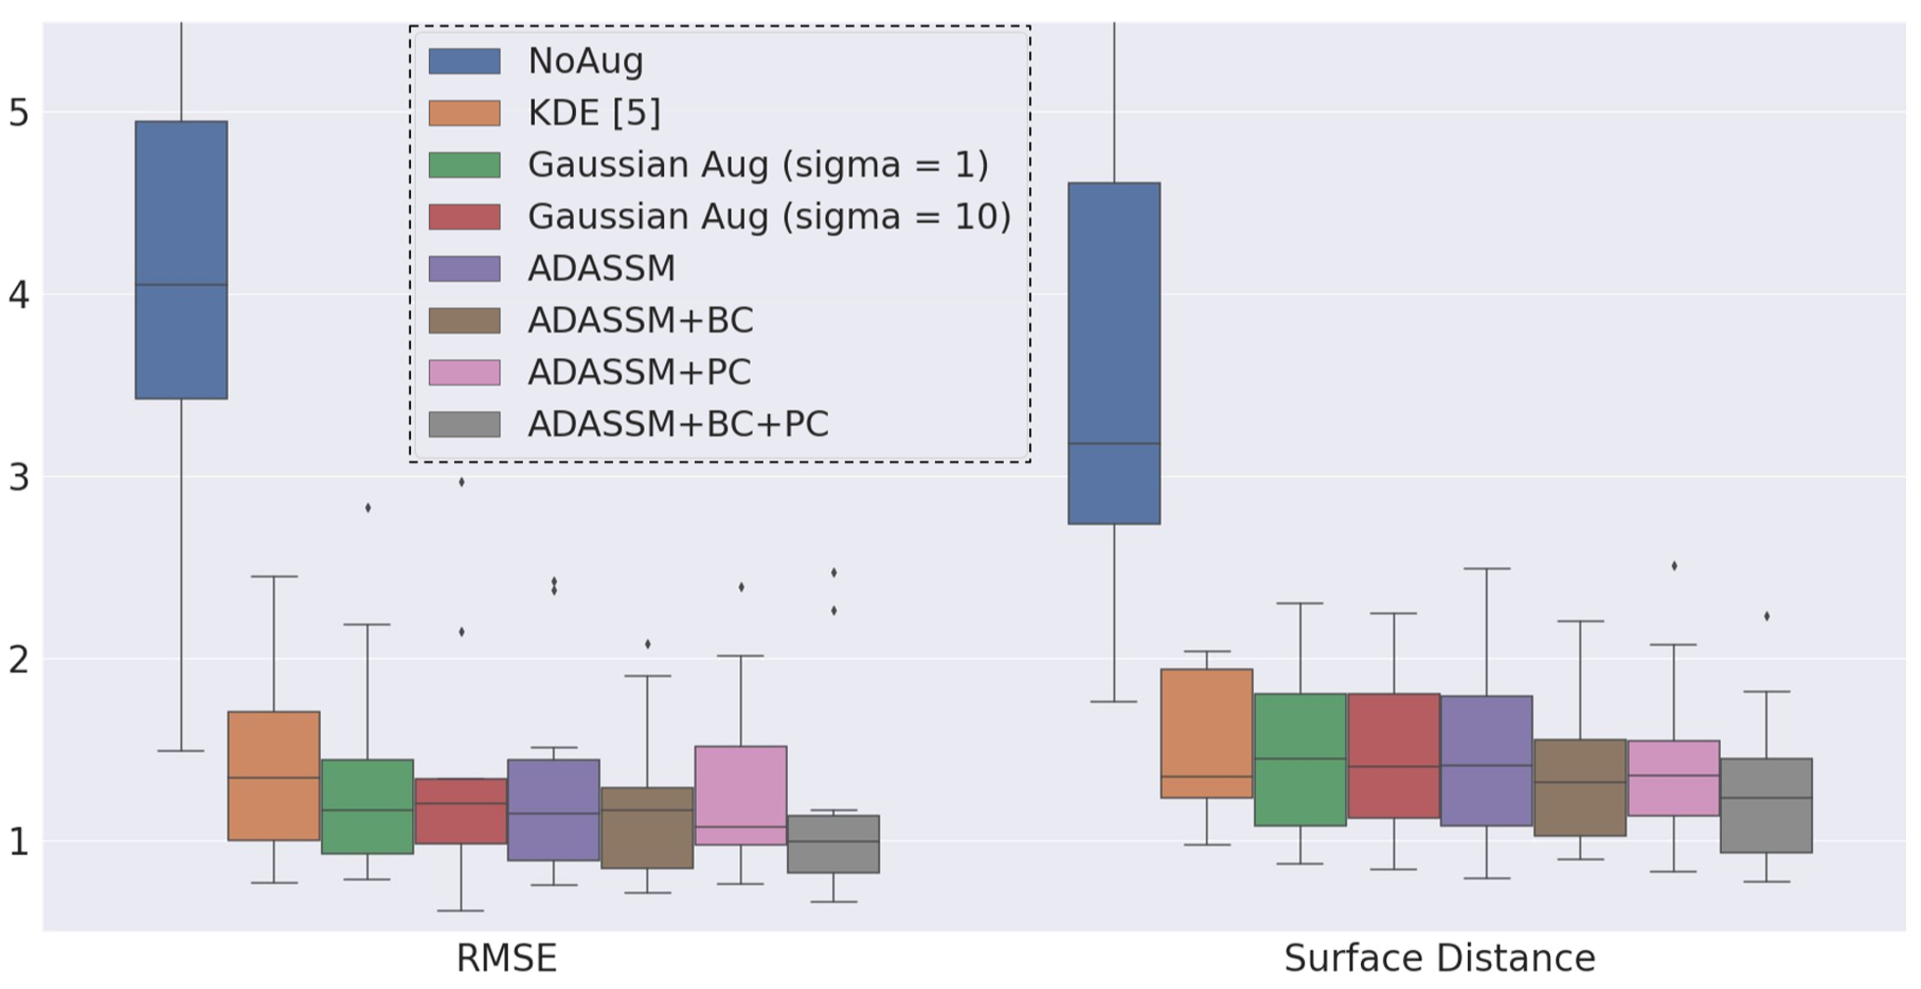
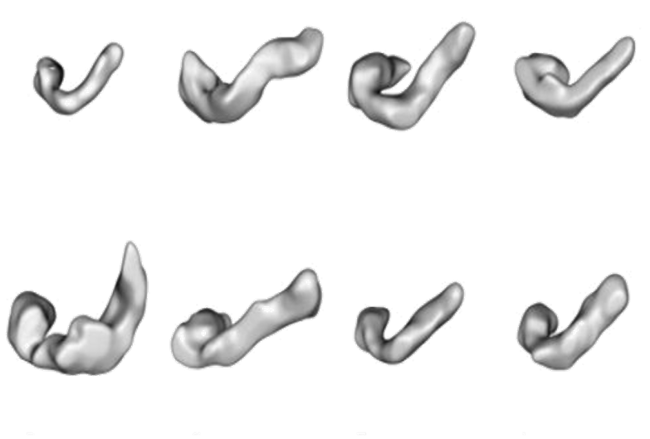
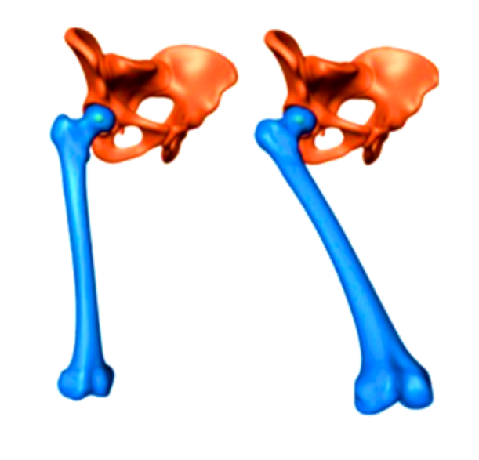
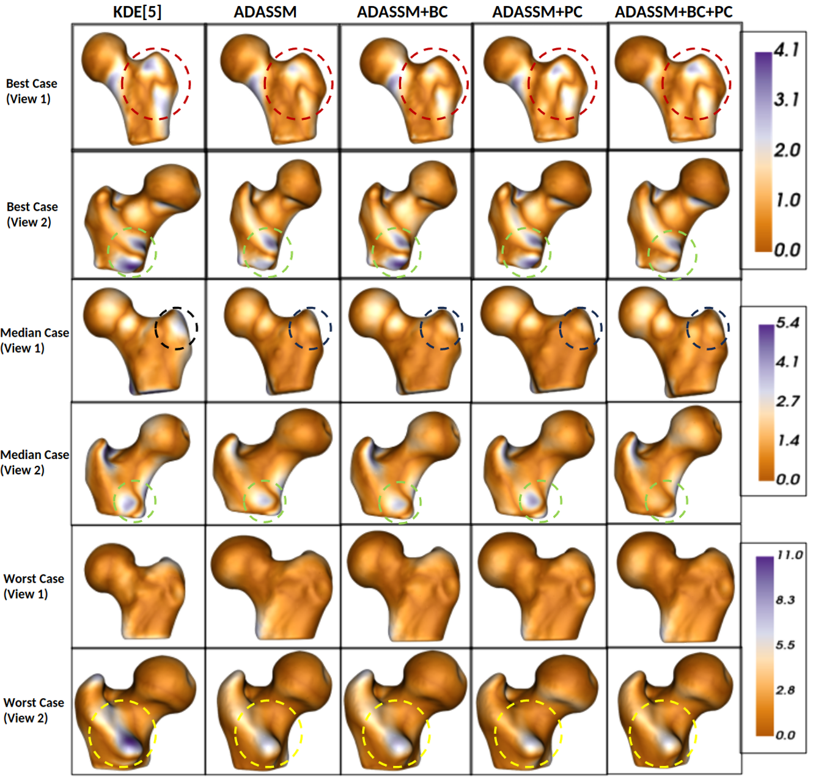
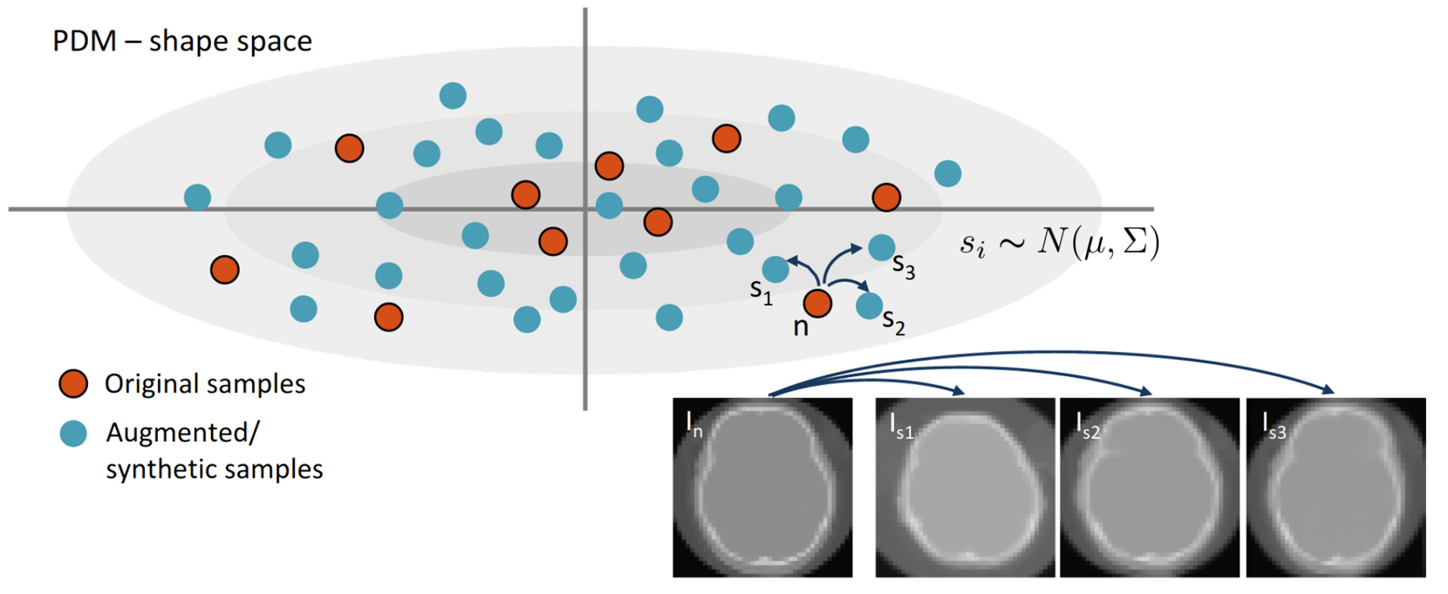
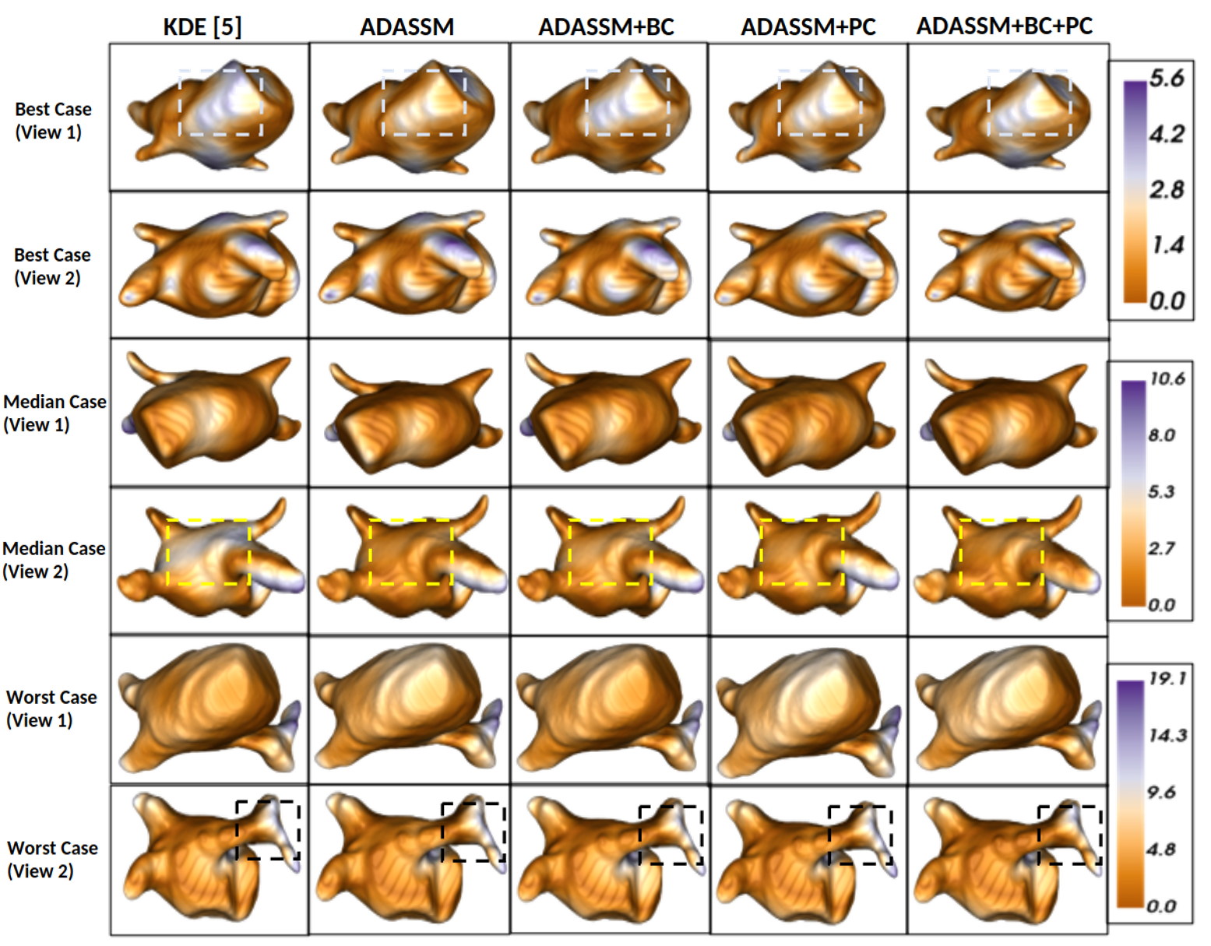
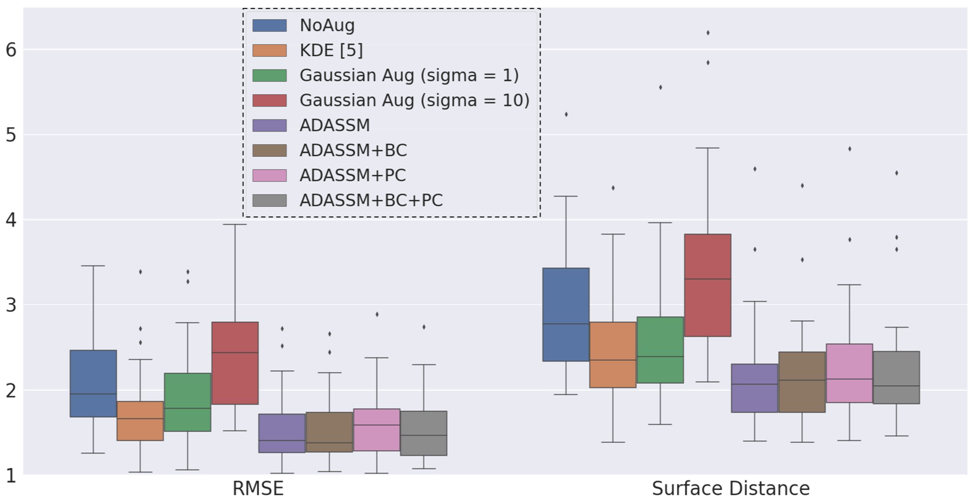
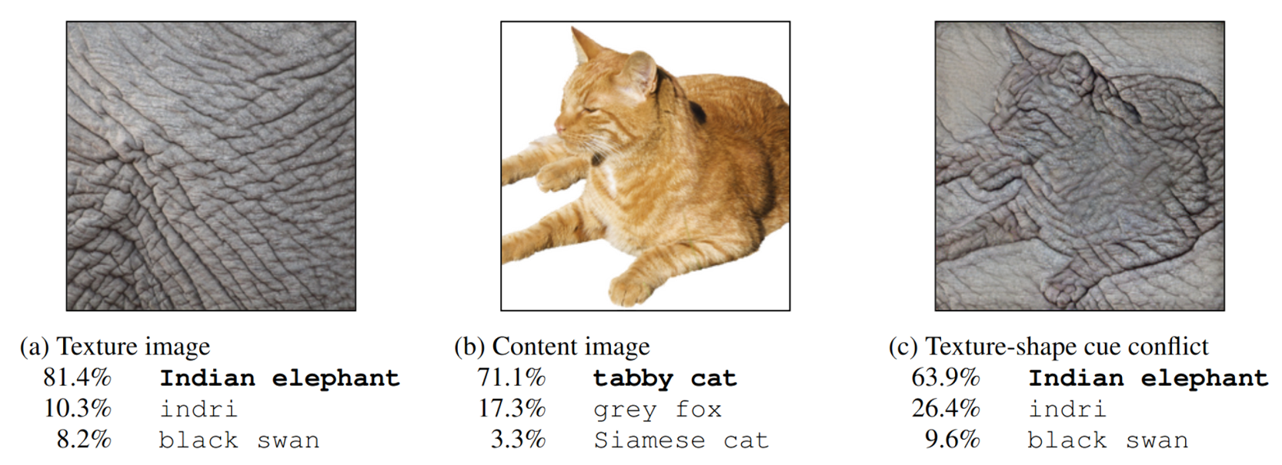
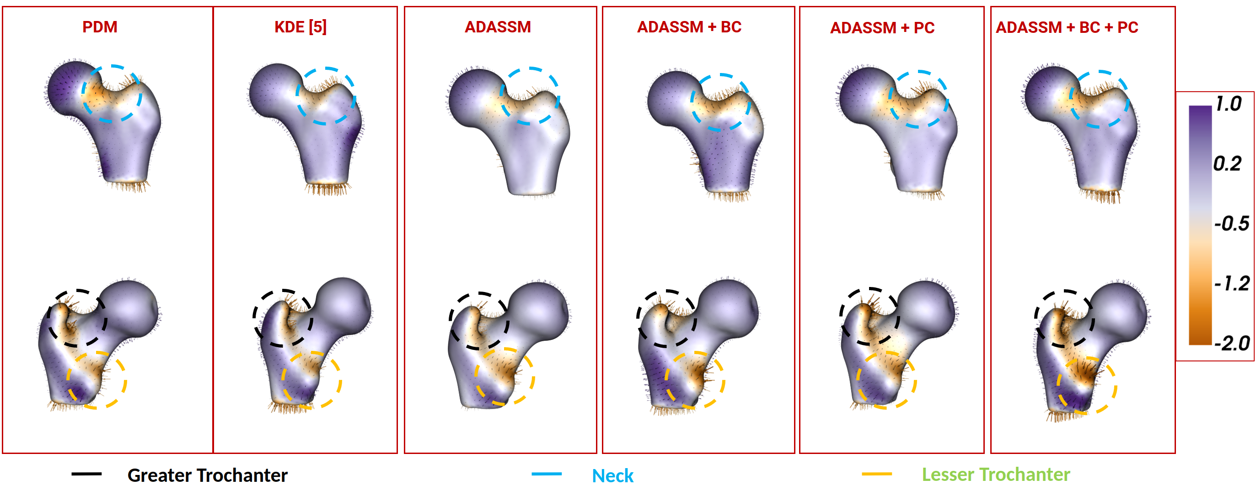
ADASSM: Adversarial Data Augmentation in Statistical Shape Models From Images Mokshagna Sai Teja Karanam, Tushar Kataria, Krithika Iyer, and Shireen Y. Elhabian {mkaranam@sci, tushar.kataria@sci, krithika.iyer@, shireen@sci}.utah.edu
Introduction
Architecture
Results - Femur
Known Parameters
Shape Representation
Error overshoots
Unknown Parameters
Traditional and Deep Learning SSM pipelines
Motivation
KDE Shape-Based Data Augmentation
Texture augmented samples are generated as an adversary to SSM
Shift from explicit shape augmentation to implicit shape attention.
Bottleneck Contrastive Loss
Particle Contrastive Loss
Reduction in errors in critical regions such as the greater trochanter, growth plate, femoral neck, and epiphyseal lines.
Results – Left Atrium
Texture Bias
Contributions
Proposed an on-the-fly adversarial data augmentation method for SSM.
Introduced Contrastive loss to project texture augmented and the corresponding original volume to the same latent representation.
Tested the approach on Left Atrium and Femur Datasets which has better generalization.
Group Differences – Down Stream Task
Reduction in errors in critical regions for the proposed models
Conclusion
Acknowledgements
References
Proposed an automated, efficient, computationally efficient adversarial data augmentation for SSM.
Showed that task dependent texture augmentation is better than fixed (Gaussian) texture augmentation and KDE based shape augmentation.
Models trained using texture augmentation also outperform on downstream tasks.
The National Institutes of Health supported this work under grant numbers NIBIB-U24EB029011, NIAMS-R01AR076120, and NIBIB-R01EB016701.
We also thank SCI and Kahlert School of Computing for the support.
[1] Gao, Yunhe, et al. "Enabling data diversity: efficient automatic augmentation via regularized adversarial training." International Conference on Information Processing in Medical Imaging. Cham: Springer International Publishing, 2021.
[2] Bhalodia, Riddhish, et al. "Deepssm: A blueprint for image-to-shape deep learning models." arXiv preprint arXiv:2110.07152 (2021).
AF Recurrence Prediction: Accuracy of AF recurrence that uses PCA scores as shape descriptors from different models.

